Slide 1
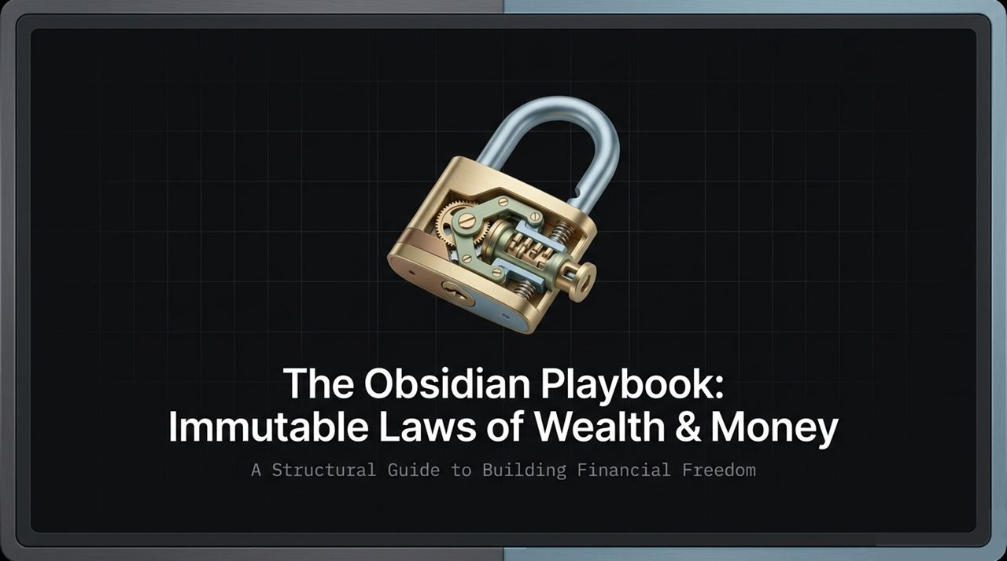
Notes:
Welcome, everyone. Today, we are breaking down the blueprint for true financial freedom through what I call The Obsidian Playbook.
Growing up, many of us are taught to view wealth as a mystery, a stroke of luck, or something reserved only for a select few. But as we’ll uncover today, wealth is neither a mystery nor a lottery—everything is structural, and everything is a contract.
When you learn to speak the contractual language of money, you shift from being a passive participant in the economy to an intentional architect of your own net worth. Over the next several slides, we’ll dive into the exact framework, laws, and engines that drive structural wealth creation.
https://www.youtube.com/watch?v=BhPWimKPD48

Slide 2
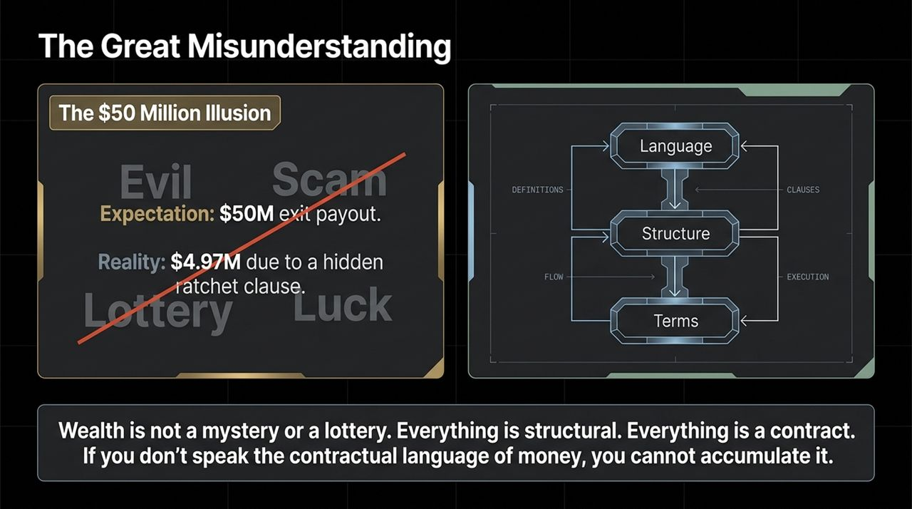
Notes:
Let’s start by looking at where most people get money wrong. Growing up in lower-middle-class environments, many of us absorb toxic narratives: that rich people are evil, that wealth comes from scams, or that financial success requires winning the lottery.
But there’s another layer to this misunderstanding—even among high earners. Take a look at the $50 Million Illusion. Early in my tech engineering career, I worked at a company that was acquired for $550 million. Based on my equity stake, I expected a payout of nearly $50 million. But when I checked my bank account at the ATM, the wire transfer was $4.97 million—a whole zero off.
Why? Because of a hidden ratchet clause in the acquisition contract that severely diluted my payout. That was my wake-up call. It wasn't about luck or hard work alone; I didn't speak the contractual language of money. That $45M lesson led me straight to business school and Wall Street to master how wealth structurally functions.

Slide 3
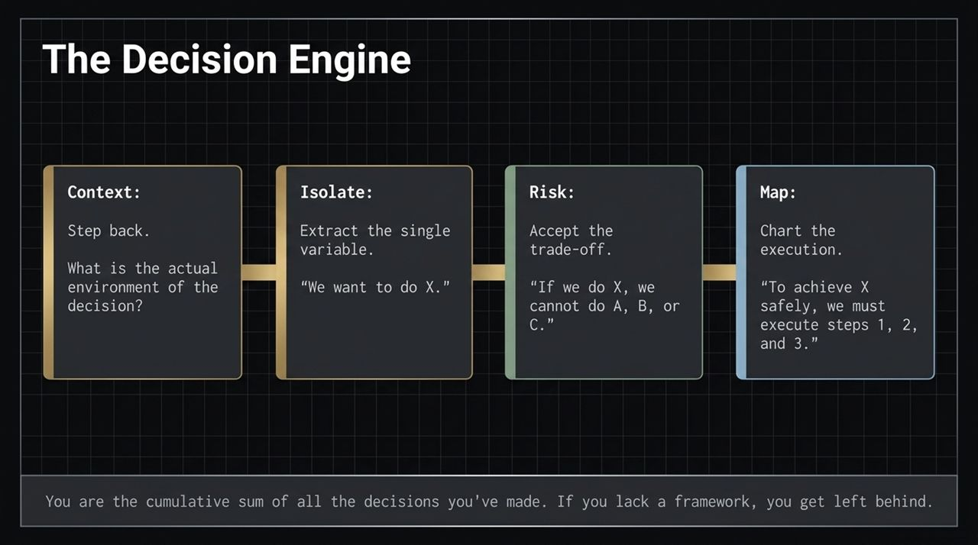
Notes:
Richard Branson once shared with me that if you don't have a clear framework for making decisions, you will always get left behind. You are the cumulative sum of every decision you’ve ever made.
To ensure consistent success, we use The Decision Engine:
Context: Step back and understand the actual environment surrounding the decision. Ask: 'What are we really talking about here?'
Isolate: Extract the single core variable or issue. Define exactly what you want to execute.
Risk: Explicitly accept the trade-offs. Recognize that 'If we choose option X, we cannot execute A, B, or C'.
Map: Chart out the step-by-step execution roadmap required to achieve option X safely.
Using this engine eliminates emotional decision-making and aligns your strategy with raw logic.

Slide 4
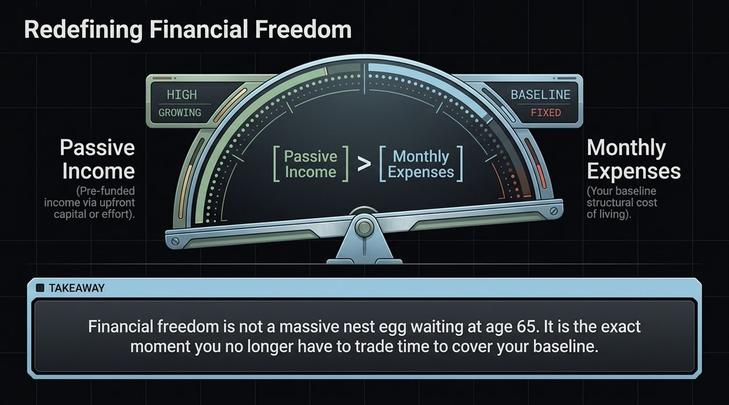
Notes:
The mainstream financial world has conditioned us to believe financial freedom is a massive pile of cash waiting for us at age 65. That model is flawed.
Real Financial Freedom happens the exact moment Passive Income exceeds your Monthly Expenses.
Monthly Expenses represent your structural baseline cost of living.
Passive Income isn't a scam or free money; it is pre-funded income generated by upfront capital or concentrated effort.
When your pre-funded cash flow covers your baseline expenses, you stop trading time for survival. You wake up every morning with total agency, asking yourself: 'What would I like to do today?'

Slide 5
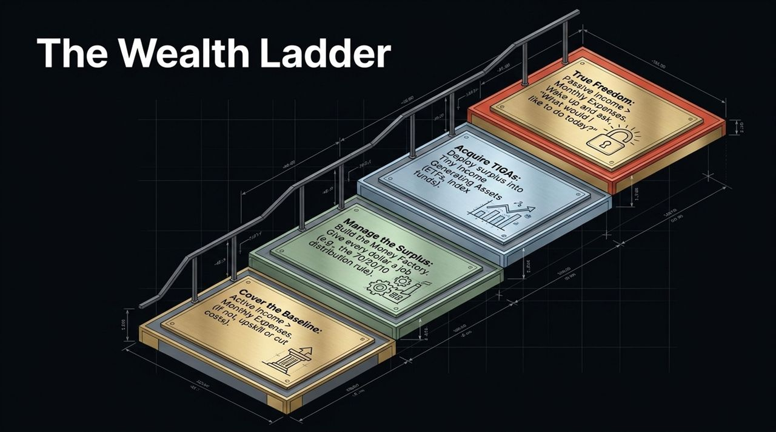
Notes:
How do we structurally reach that point? We climb The Wealth Ladder rung by rung:
Rung 1: Cover the Baseline. Ensure Active Income > Monthly Expenses. If it isn't, cut expenses or aggressively upskill to boost your income.
Rung 2: Manage the Surplus. Build a 'Money Factory'. Give every single dollar a job using automated distribution systems, such as the 70/20/10 rule (70% lifestyle, 20% savings, 10% investing).
Rung 3: Acquire TIGAS. Deploy your surplus into Tiny Income Generating Assets (like index funds, ETFs, or fractional real estate).
Rung 4: Achieve True Freedom. Stack those TIGAS until your Passive Income completely overshadows your Monthly Expenses.
Climbing this ladder strips away market noise and gives you a clear target at every stage.

Slide 6
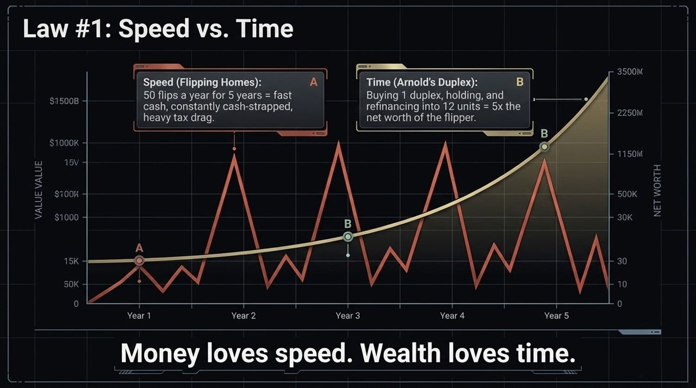
Notes:
Law #1 states: Money loves speed, but Wealth loves time.
Consider two investors:
Investor A (Speed): Flipping 50 homes a year. On paper, it generates fast cash. But because of heavy tax drag and constant capital recycling, Investor A remains chronically cash-strapped.
Investor B (Time): Following the Arnold Schwarzenegger approach—buying a single duplex, holding it, letting time compound the asset, and refinancing into a 4-plex and eventually 12 units.
Over 5 years, Investor B accumulates 5 times the net worth of Investor A with far less operational friction. Rapid transactions generate short-term income, but holding compounding assets over time builds generational wealth.

Slide 7
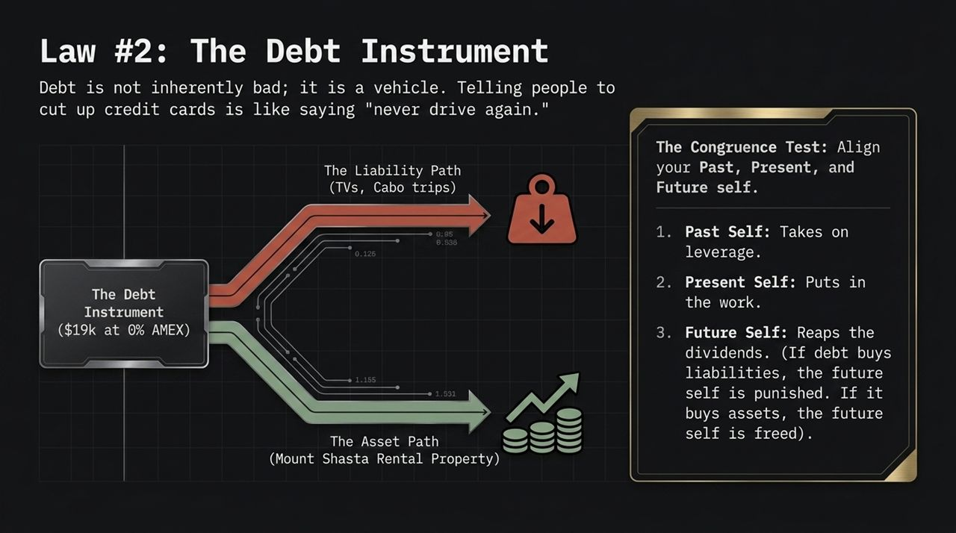
Notes:
Telling people to cut up their credit cards is like telling someone who bought a car to never drive again because driving can be dangerous. Debt is not inherently evil—it is simply a financial vehicle.
The Liability Path: Using debt (e.g., credit cards) for discretionary expenses like luxury trips or consumer electronics.
The Asset Path: Utilizing 0% introductory credit cards to acquire income-producing assets (like securing a rental property down payment).
To manage leverage, apply The Congruence Test across your Past, Present, and Future selves:
Past Self takes on leverage strategically.
Present Self puts in the work to manage it.
Future Self reaps the cash flow dividends. If debt buys liabilities, your future self is punished; if it buys cash-flowing assets, your future self is freed.

Slide 8
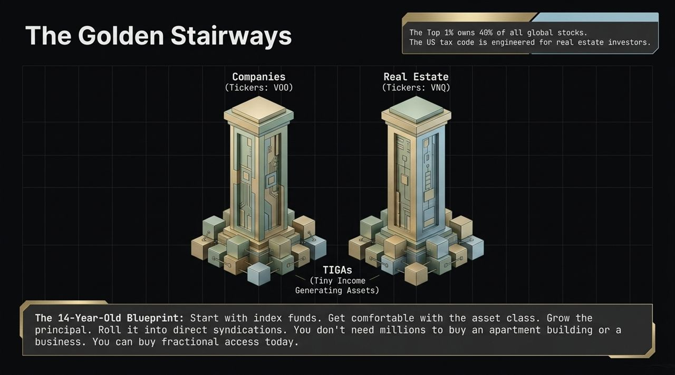
Notes:
There are only two main stairways guaranteed to build wealth in the modern financial system: Companies and Real Estate.
Companies (e.g., Ticker: VOO): The top 1% of the world owns nearly 40% of all global equities.
Real Estate (e.g., Ticker: VNQ): The U.S. tax code is engineered specifically to reward real estate owners.
You don't need millions to enter these markets. Take The 14-Year-Old Blueprint: start fractional access immediately by putting small amounts into broad index ETFs (VOO and VNQ). Build principal in these core asset classes, gain comfort, and eventually roll that capital into direct real estate syndications or private company equity.

Slide 9
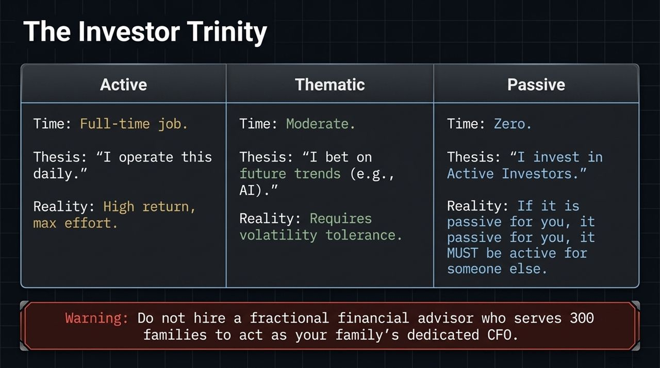
Notes:
Before deploying capital, you must identify where you sit within The Investor Trinity:
Active Investor: Full-time operator. High potential returns, maximum effort.
Thematic Investor: Bets on long-term technological or macro trends (like AI or renewable tech) and tolerates market volatility.
Passive Investor: Allocates capital to Active Investors.
Critical Rule: If an investment is passive for you, it MUST be active for someone else. A major mistake families make is hiring a fractional financial advisor with 300 clients to serve as their dedicated family CFO. If no one is actively stewarding your specific nest egg, your capital is vulnerable.

Slide 10
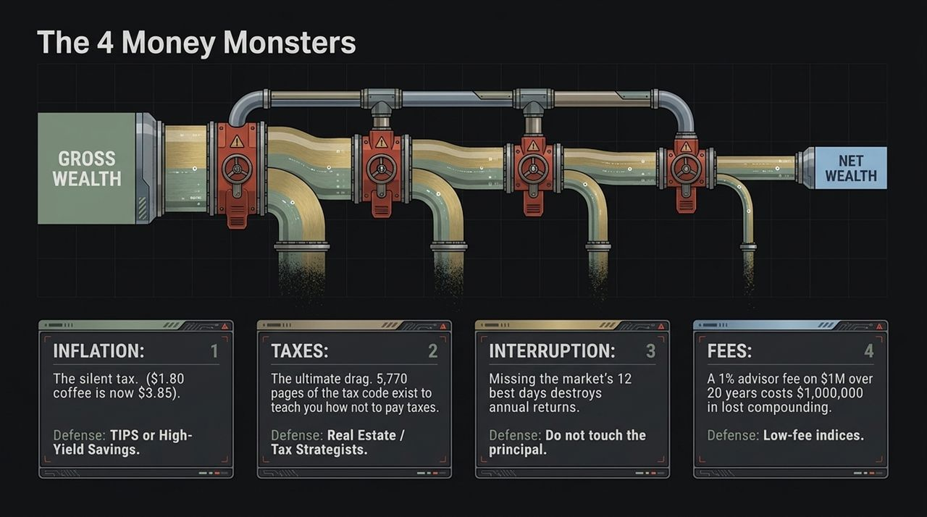
Notes:
Charlie Munger noted that building wealth is often less about brilliant moves and more about avoiding mistakes. We face 4 Money Monsters that quietly erode wealth:
Inflation: The silent tax. (Defense: High-Yield Savings or TIPS - Treasury Inflation-Protected Securities).
Taxes: The biggest drag on capital. Over 5,700 pages of the tax code exist to detail legal tax incentives and deductions. (Defense: Real Estate and Tax Strategists).
Interruption: Pulling capital out during down-markets. Missing just the 12 best market days in a year can eliminate annual gains. (Defense: Hold principal intact).
Fees: A 1% advisory fee on $1M over 20 years forfeits roughly $1,000,000 in lost compounding growth. (Defense: Low-cost index funds).

Slide 11
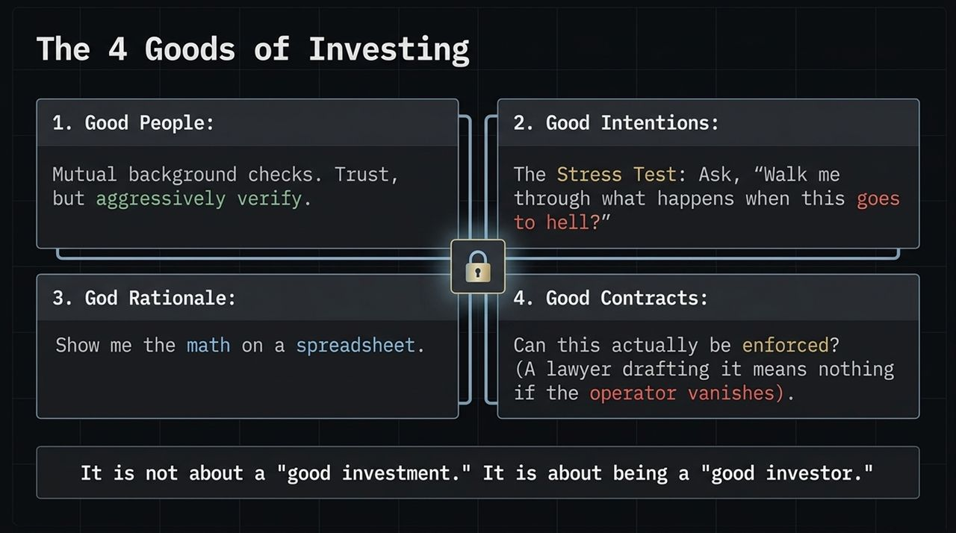
Notes:
After losing $1 million on an investment due to a fraudulent operator who vanished, I developed The 4 Goods Framework for evaluating opportunities:
Good People: Execute mutual background checks. Trust, but aggressively verify.
Good Intentions: Run the stress test—ask, 'Walk me through step-by-step what happens if this goes completely wrong?'
Good Rationale: Review the underlying financial mechanics directly on a spreadsheet.
Good Contracts: Ensure legal enforceability. Having a lawyer draft an agreement is useless if the operator cannot be served.
Remember: It's not just about finding a 'good investment'—it's about becoming a disciplined, 'good investor'.

Slide 12
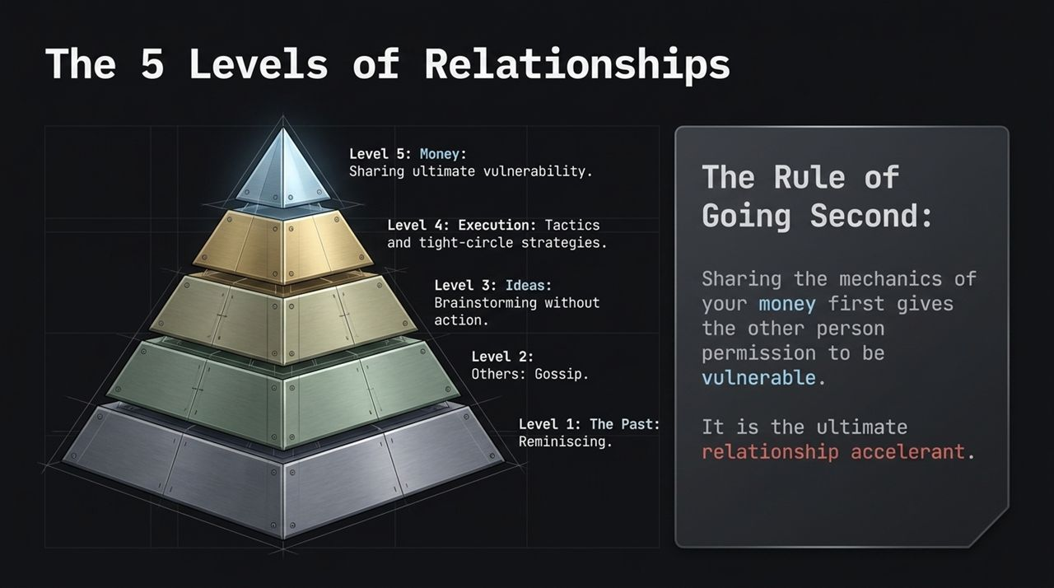
Notes:
Your business network dictates your execution capacity. Relationships operate across five distinct levels:
Level 1 (The Past): Reminiscing about old times.
Level 2 (Others): Gossip and small talk.
Level 3 (Ideas): Brainstorming concepts without taking action.
Level 4 (Execution): Strategic, tactical inner-circle collaboration.
Level 5 (Money): Deep contractual vulnerability and financial clarity.
To build high-level partnerships fast, practice The Rule of Going Second. When you voluntarily share the mechanics of your numbers first, you give others permission to be vulnerable, accelerating trust dramatically.

Slide 13
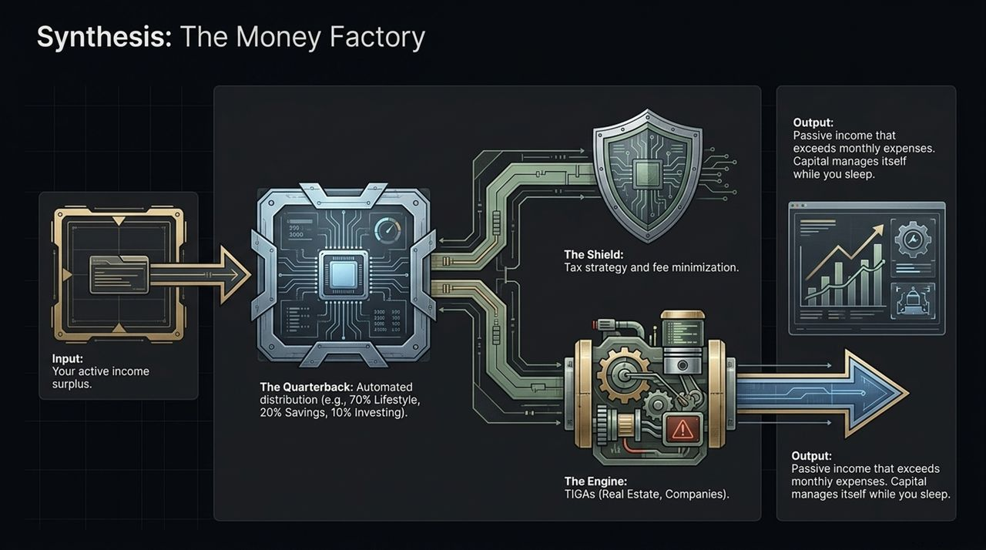
Notes:
Now let's synthesize these laws into an operational system: The Money Factory.
Input: Active income surplus generated from your primary career or business.
The Quarterback: Automated allocation systems that route funds directly upon arrival (e.g., 70% Lifestyle, 20% Savings, 10% Investment).
The Shield: Tax strategy, inflation hedges, and fee minimization that guard your capital from erosion.
The Engine: Real estate and company assets (TIGAS) working continuously.
Output: Reliable passive income that systematically exceeds monthly living expenses—allowing your capital to manage itself while you sleep.

Slide 14
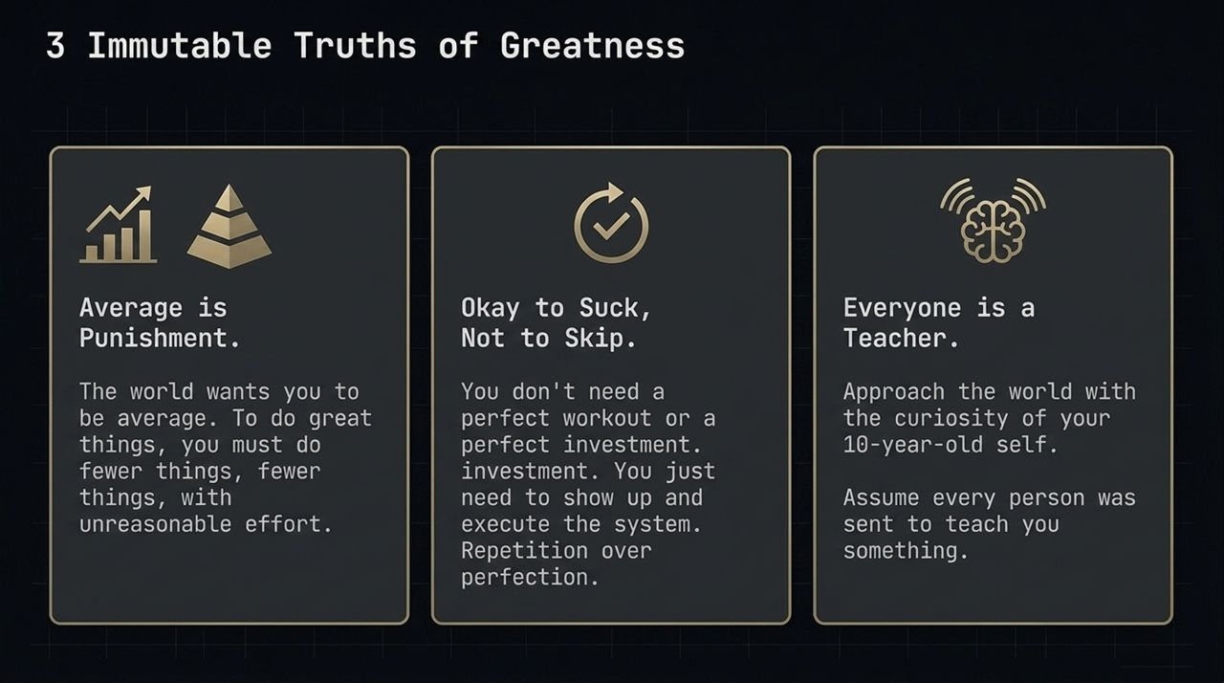
Notes:
Sustaining a wealth strategy requires specific mindset principles:
Average is Punishment: The world constantly pressures you to conform to mediocrity. To achieve extraordinary outcomes, do fewer things with unreasonable effort.
Okay to Suck, Not to Skip: Consistency beats sporadic perfection. You don't need a flawless investment or perfect execution every day—you just need to show up and execute the system repeatedly.
Everyone is a Teacher: Approach business and life with childlike curiosity. Assume every individual you encounter was sent to teach you a valuable lesson.

Slide 15
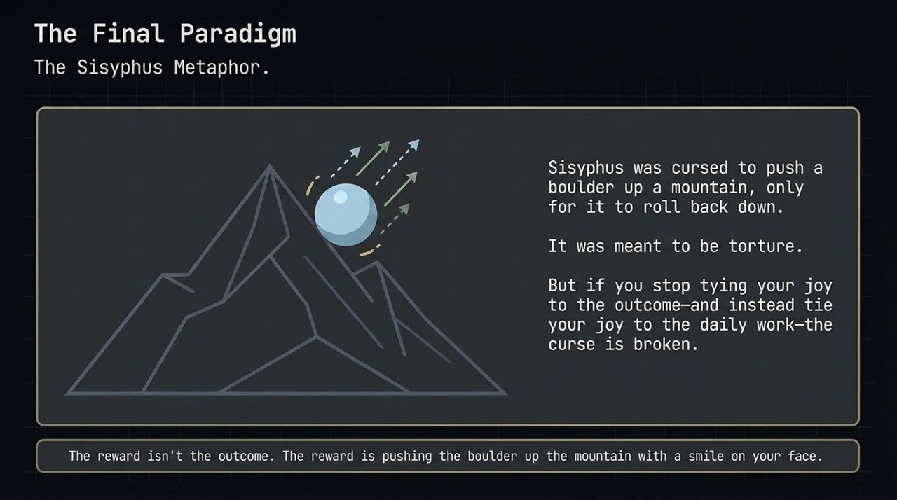
Notes:
We close with The Sisyphus Metaphor.
In Greek mythology, Sisyphus was condemned by the gods to push a heavy boulder up a mountain, only to watch it roll back down every time he reached the top. It was designed as eternal torture.
But Sisyphus realized something profound: if he detached his joy from the final outcome and attached it entirely to the process of pushing, the punishment vanished.
True financial mastery follows the same paradigm. The ultimate reward isn't just reaching a specific net-worth destination; it's mastering the craft, executing the daily operations, and pushing the boulder up the mountain with a smile on your face.

Slide 16
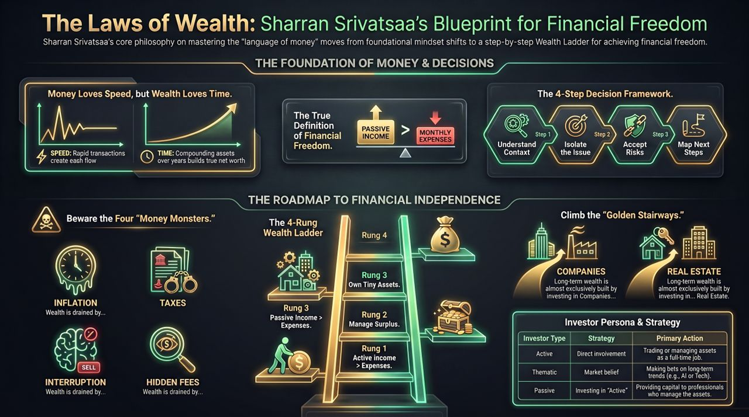
Notes:
To summarize our complete playbook:
Mindset & Mechanics: Money loves speed, but true wealth requires time. Use the 4-step Decision Framework to maintain clarity on every major choice.
Defense: Actively shield your capital from the 4 Money Monsters: Inflation, Taxes, Interruption, and Hidden Fees.
Roadmap: Climb the Wealth Ladder by securing active surplus, acquiring TIGAS, and focusing on the two main stairways—Companies and Real Estate.
Execution: Know your investor persona—whether Active, Thematic, or Passive—and ensure your passive assets are managed by dedicated active stewards.
Master these structural principles, speak the language of money, and build a system designed for lasting freedom. Thank you.

